Slide 1





Room 202
Room 202
Toilet
Room 202
An Efficient Indoor Shortest Path Determination System with Streamlined Dataset Collection
Room 202
Room 202
Room 202
Room 202
Room 202
Room 202
Room 202
Room 202
Room 202
Room 202

Slide 2




Project Supervisor
Md Mostofa Kamal Rasel
Assistant Professor
Department of Computer Science and Engineering
Project Member
Sakibur Rahaman
Anik Lal Dey
Firoz Mahmud Rizvi
2019-3-60-028
Kazi Sifat Al Maksud
2020-1-60-228
2019-2-60-076
2019-3-60-050

Slide 3

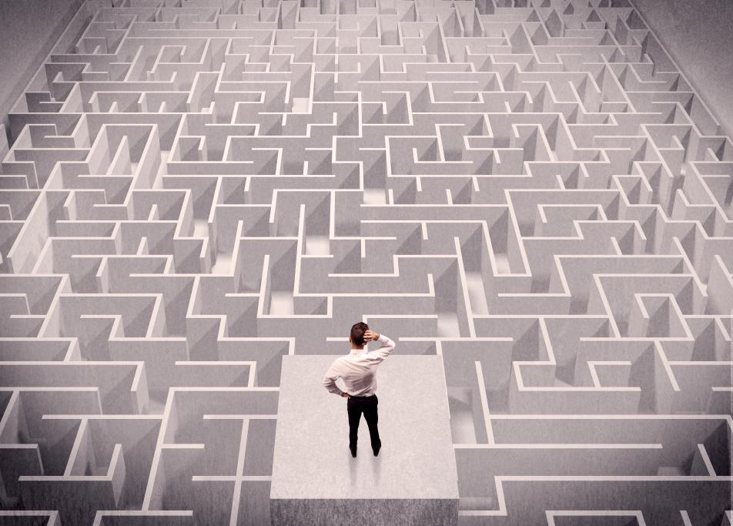


Background
Navigating through large indoor spaces can be a daunting task. Any complex indoor environment, finding our way around can be a challenge.
Large shopping mall
Hospital
Airport
University

Slide 4




Related Works
Indoor Google Maps
Google obtain floor plans from building owners or managers to create accurate indoor maps.
Google Maps uses a combination of these technologies to provide indoor positioning such as Wi-Fi, Bluetooth, Magnetic positioning.
FootPath
Step detection and step heading detection
match detected steps onto the expected route from the source to the destination using sequence alignment algorithms. [2]
Door To Door Approach
The approach is designed to support natural movement in buildings, particularly during emergencies.
The algorithm is applied to 2D floor plans of buildings with complex indoor structures and consists of two-level routing [1]
4
Navigating MazeMap
Show the spatial and temporal distribution of MazeMap geo-location and wayfinding requests.
Findings are specific to the venue.
Location-based services predict a successful future for these systems and applications. [3]
1. Liu, L., & Zlatanova, S. (2011). A" door-to-door" path-finding approach for indoor navigation. Proceedings Gi4DM 2011:
GeoInformation for Disaster Management, Antalya, Turkey, 3-8 May 2011.
3. J. Á. B. Link, P. Smith, N. Viol and K. Wehrle, "FootPath: Accurate map-based indoor navigation using smartphones," 2011 International Conference on Indoor Positioning and Indoor Navigation, Guimaraes, Portugal, 2011, pp. 1-8, doi: 10.1109/IPIN.2011.6071934.
2. Link, J. A. B., Smith, P., Viol, N., & Wehrle, K. (2011). FootPath: Accurate map-based indoor navigation using smartphones. 2011 International Conference on Indoor Positioning and Indoor Navigation. doi:10.1109/ipin.2011.6071934

Slide 5


Observation
there are not enough access points or beacons installed in an indoor space, the accuracy of the location data collected will be limited.
it is difficult to deploy wifi technologies and its not user-friendly.
Bluetooth has a limited range of about 10 meters.
it difficult to accurately track the location of a user within a large indoor space.
It's not cost-efficient.
Other technologies such as ultra-wideband (UWB), RFID, RSSI.
Main think is that the data collection is not easy in the indoor navigation system.

Slide 6

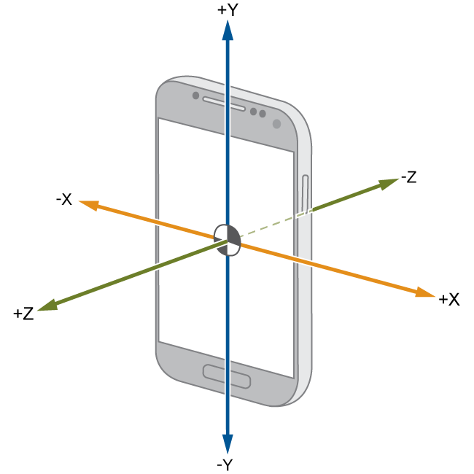
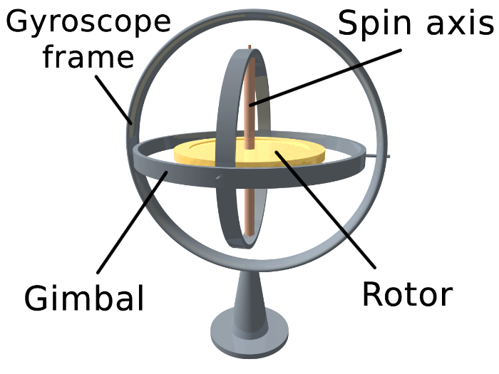
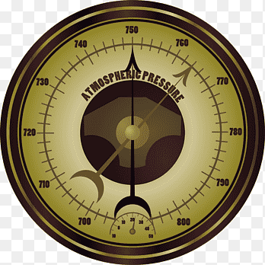
Indoor Navigation Using Android Sensors for Navigation:
Accelerometer
Gyroscope
Magnetometer
Barometer
Proximity
Why Use Android Sensors ?
1.Ubiquity
2.Low cost
3. User familiarity
4. Versatility
5 .No additional hardware required

Slide 7


Objectives
To offer precise and efficient navigation inside a large building or a complicated structure.
1
Business proposals can boost revenues for your firm
To help visitors who are unfamiliar with the layout of the building, older people, and those with disabilities.
2
To help users reach their desired destinations with minimum time and effort.
Step 1
Business proposals can boost revenues for your firm
3
4
To offer a user-friendly interface that is simple to use and comprehend.
To provide real-time information of a user about his or her current location inside the indoor and the best route to reach the destination.
Step 1
Business proposals can boost revenues for your firm
5
6
To boost security and lower the chance of becoming lost or confused inside the structure.

Slide 8
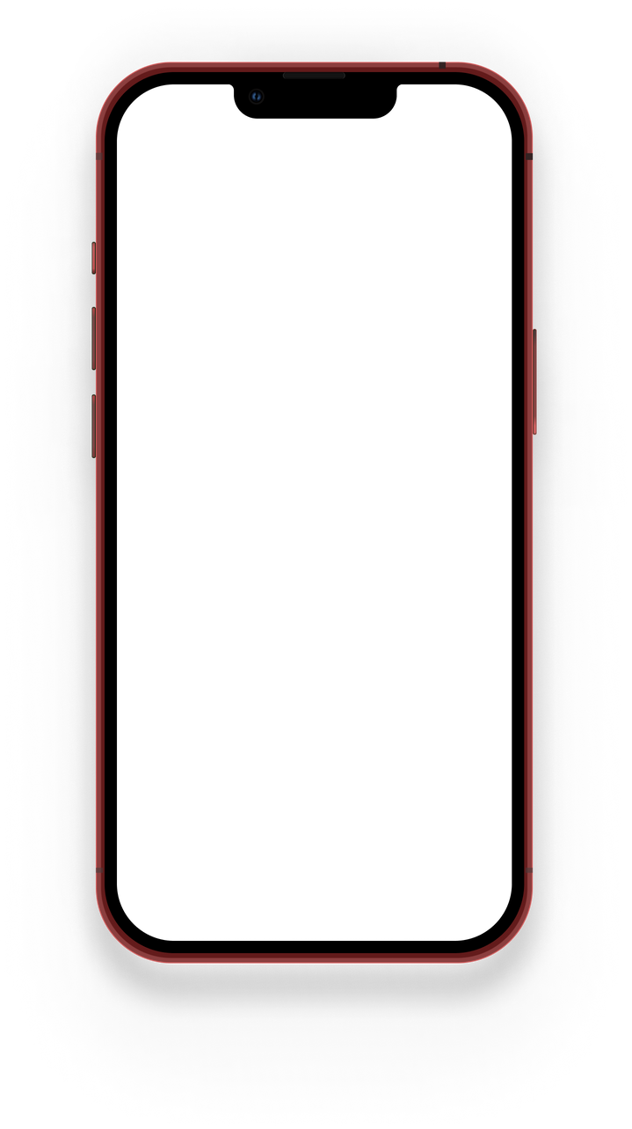
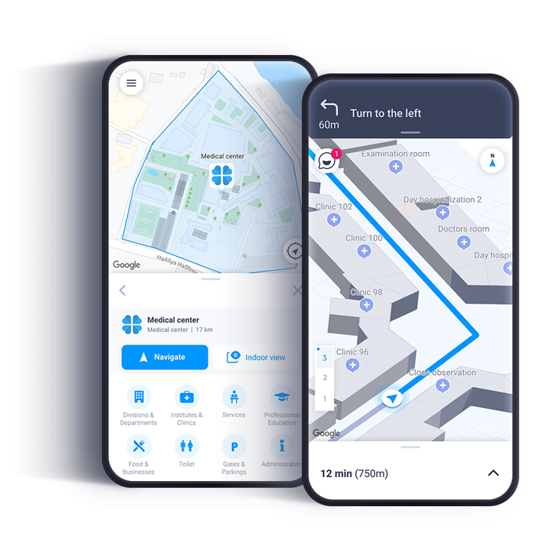
Dataset
How We Collecting Data

Slide 9
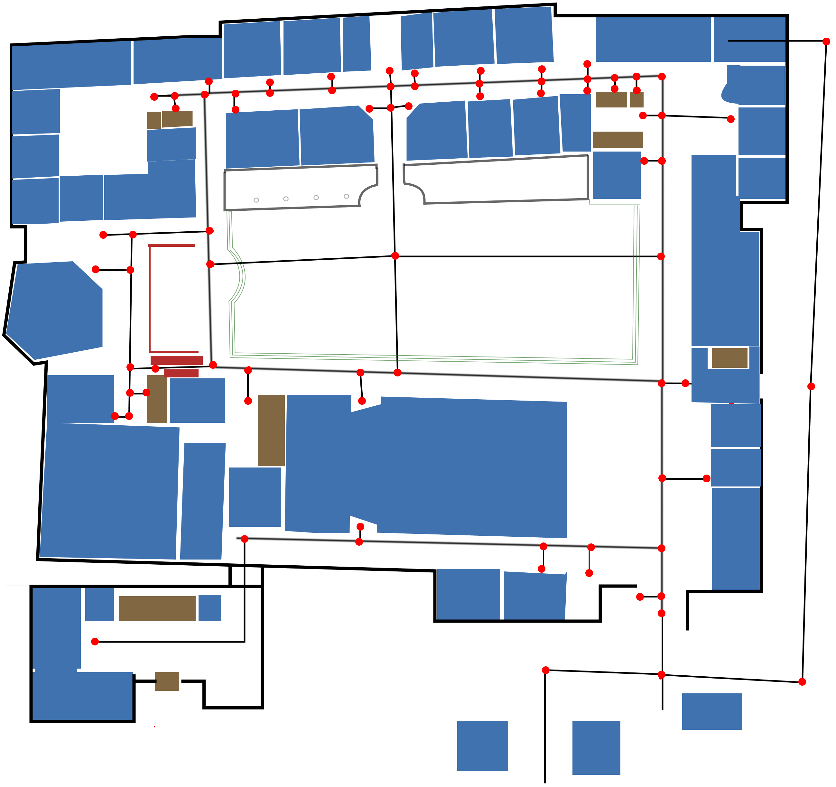
Collecting Data
Site 1
Location: (EWU Ground Floor)
Room Area Spaces
Node
Pathway
Lift
Identifying the Nodes.
Each Node contained minimum three data ( x, y, z etc.)
There will be mandatory nodes for each door front and path corner.
Each Node is connected by a line.
Every node to node contained a weight value.

Slide 10
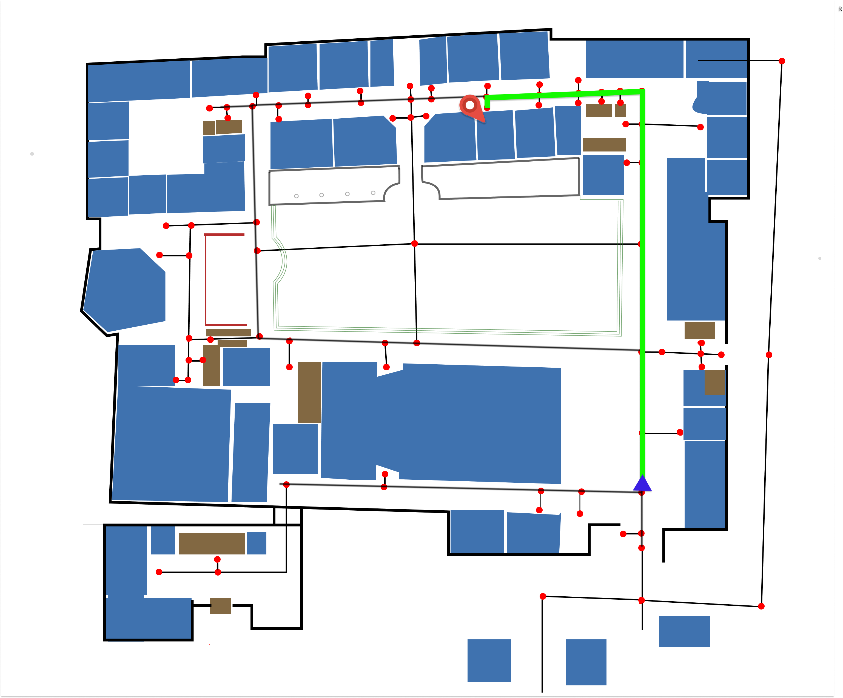
Uses of Dataset
Site 1
Location: (EWU Ground Floor)
If the user needs to navigate from main entry point (Source) to room number 110 (Destination).
Room Area Spaces
Node
Pathway
Lift
Source
Destination
Shortest Path

Slide 11







Problem statements
What are the methods and algorithms are used for find the user real time location?
How can we collect data for the pathfinding system?
How can the system be made user-friendly and accessible for individuals with varying levels of technical proficiency?
What are the algorithms used for pathfinding and how effective are they?
Mobile sensors such as accelerometers, gyroscopes, and magnetometers can be affected by environmental factors such as magnetic fields, vibration, and temperature changes. These factors can cause errors in sensor readings. So that will be a problem.
What are the security and privacy implications of using an indoor positioning system and how can they be addressed?

Slide 12
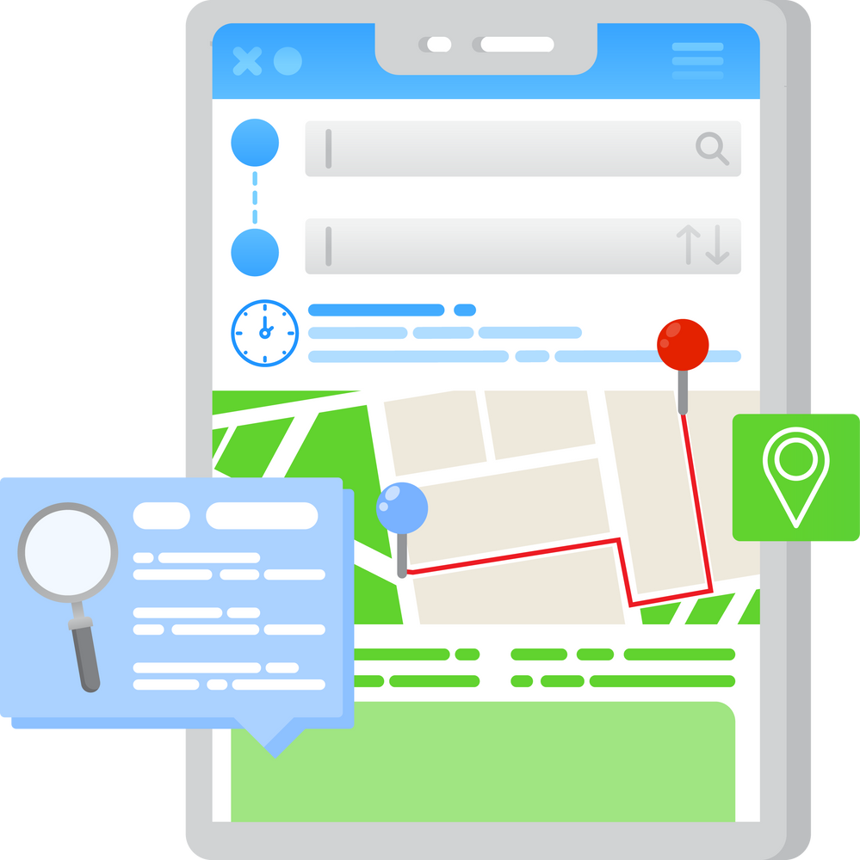
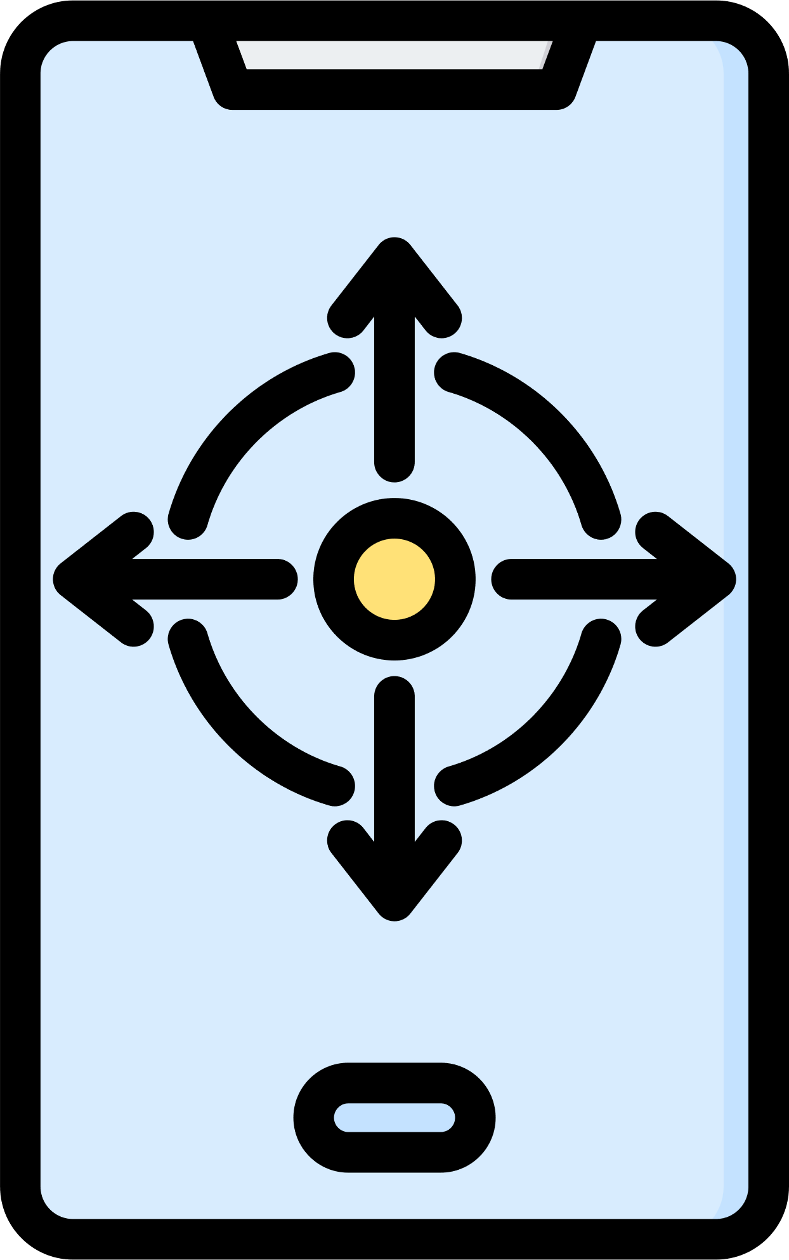

Positioning
1
To determine the position of a user we will mobile sensors like an accelerometer, gyroscope, and magnetometers to collect data on the movement and orientation of a device and with the help of this we will be able to track the real time position of a user.
Planning Step

Slide 13
To determine the shortest path, a variety of algorithms can be utilized, including Breadth First Search (BFS), Depth First Search (DFS), Breadth First search, Dijkstra's Algorithm, etc. To finding the shortest path, we'll apply Dijkstra's algorithm.
3
Shortest path find
2
Data set
We need to design a architectural plans of the structure. These designs help to produce a digital map. and then determine nodes and their distances from one another as well. There are two methods for collecting the distances .One is we can manually enter the distance value or utilize an accelerometer sensor to detect the distance by moving past these nodes.

Slide 14
The system will be designed with software that utilizes mobile sensors technology to calculate the real time location and use a shortest path algorithm for calculating the shortest path of user desire destination.
4
Implementation

Slide 15
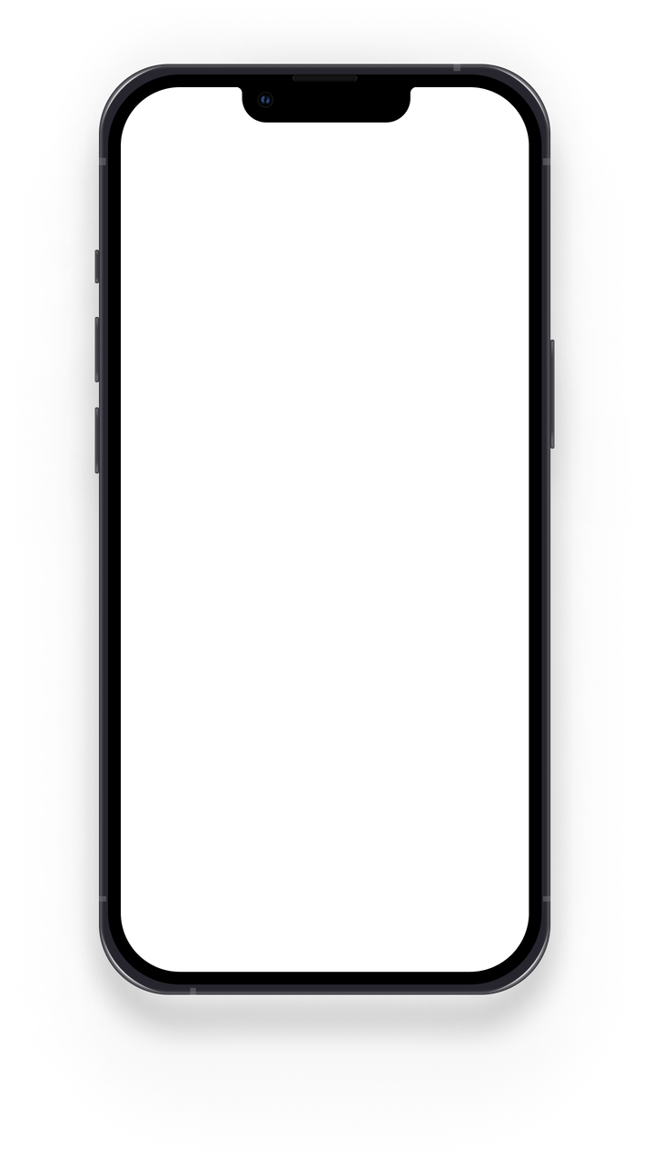
Final Product
It will be able to determine the shortest path between two points inside a building .It offers real-time, step-by-step navigational assistance this helps a user to find his or her real time location or position inside a building .It will be able to provide a visual representation of the building's floor plan together with important landmarks and data to a user as a result a user will be able to understand the structure of the building.

Slide 16

Reference:
1. Liu, L., & Zlatanova, S. (2011). A" door-to-door" path-finding approach for
indoor navigation. Proceedings Gi4DM 2011: GeoInformation for Disaster
Management, Antalya, Turkey, 3-8 May 2011.
2. Wu, H., Marshall, A., & Yu, W. (2007, July). Path planning and following
algorithms in an indoor navigation model for visually impaired. In Second
International Conference on Internet Monitoring and Protection (ICIMP 2007) (pp.
38-38). IEEE.
3. Yasir, M., Ho, S. W., & Vellambi, B. N. (2014). Indoor positioning system using
visible light and accelerometer. Journal of Lightwave Technology, 32(19), 3306-3316.
4. Hindawi, et al. “Practical Fingerprinting Localization for Indoor Positioning
System by Using Beacons.” Practical Fingerprinting Localization for IndoorPositioning System by Using Beacons, 2017, https://doi.org/10.1155/2017/9742170.
5.“Applied Mathematics - SCIRP.” Applied Mathematics - SCIRP,
www.scirp.org/journal/am.
6. “A Systematic Literature Review of a* Pathfinding.” A Systematic Literature
Review of a* Pathfinding - ScienceDirect, 2021,https://doi.org/10.1016/j.procs.2021.01.034.

Slide 17
7. Dian Rachmawati and Lysander Gustin 2020 J. Phys.: Conf. Ser. 1566 012061
8. Iloh, Princess Chinemerem. “A COMPREHENSIVE AND COMPARATIVE
STUDY OF DFS, BFS, AND a* SEARCH ALGORITHMS IN a SOLVING THE
MAZE TRANSVERSAL PROBLEM | International Journal of Social Sciences and
Scientific Studies.” A COMPREHENSIVE AND COMPARATIVE STUDY OF DFS,
BFS, AND a* SEARCH ALGORITHMS IN a SOLVING THE MAZE TRANSVERSAL
PROBLEM | International Journal of Social Sciences and Scientific Studies, 2022,
ijssass.com/index.php/ijssass/article/view/54.
9. Xia, Shixiong, et al. “Indoor Fingerprint Positioning Based on Wi-Fi: An
Overview.” MDPI, 2017, https://doi.org/10.3390/ijgi6050135.
10. “Privacy-preserving Indoor Localization Based on Inner Product Encryption in a
Cloud Environment.” Privacy-preserving Indoor Localization Based on Inner
Product Encryption in a Cloud Environment - ScienceDirect, 2021,
https://doi.org/10.1016/j.knosys.2021.108005
11. “User Location Privacy Protection Mechanism for Location-based Services.”
User Location Privacy Protection Mechanism for Location-based Services -
ScienceDirect, 2020, https://doi.org/10.1016/j.dcan.2020.07.012.

Slide 18
12. Link, J. A. B., Smith, P., Viol, N., & Wehrle, K. (2011). FootPath: Accurate map-based indoor navigation using smartphones. 2011 International Conference on Indoor Positioning and Indoor Navigation. doi:10.1109/ipin.2011.6071934

Slide 19
THANK YOU
Q/A

